Slide 1
Project 5
Mobile Price Prediction using machine learning

Slide 2
Objective:
Predict the Mobile Price range of mobile phones based on their specification.
Dataset – Features include RAM, Battery, camera, memory, processor and screen size.

Slide 3
Data Cleaning:
Checked missing values, duplicate records and corrected value e.g.
df.duplicated().sum()
df.isnull().sum()

Slide 4
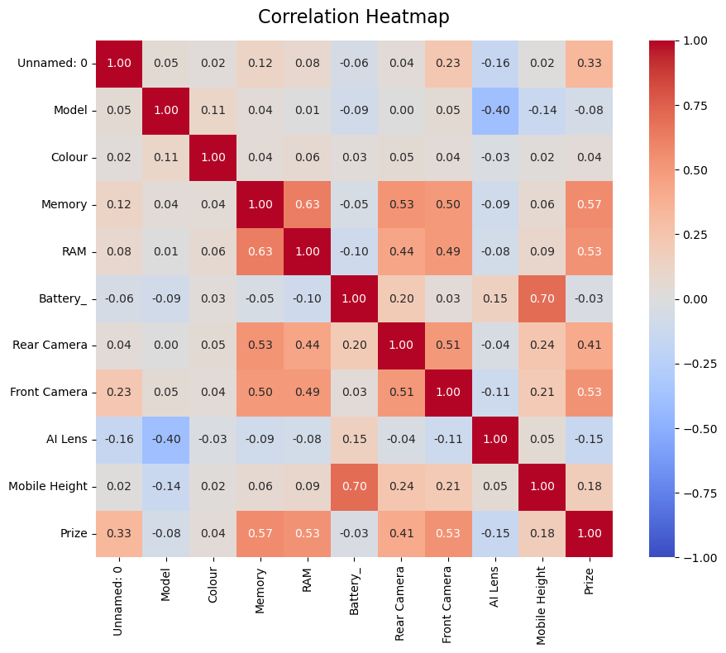
Exploratory Data Analysis(EDA)
EDA analysed features as distributions, correlations, and relationships using charts.

Slide 5
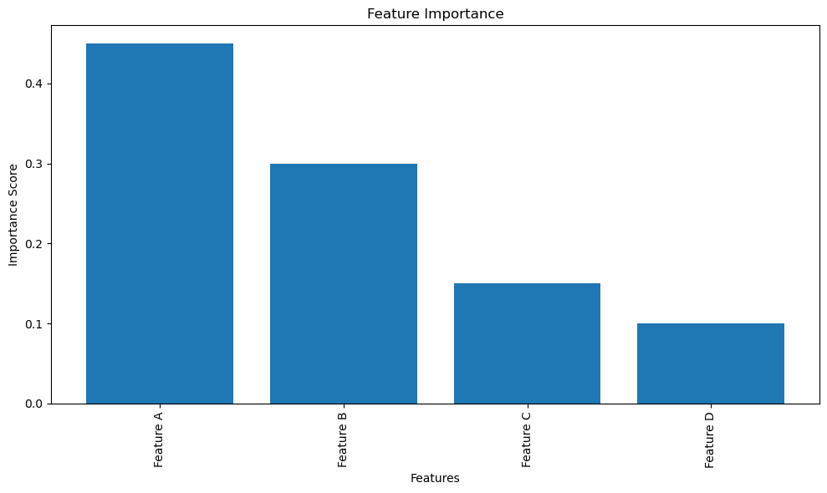
Feature Engineering:
Seleceted important features and prepare data.

Slide 6
Conclusion:
Machine learning can effectively predict mobile price, helping customers and businesses make informed decisions.

Slide 7
Future Scope:
Improve accuracy using advanced algorithms and larger dataset.

